Slide 1
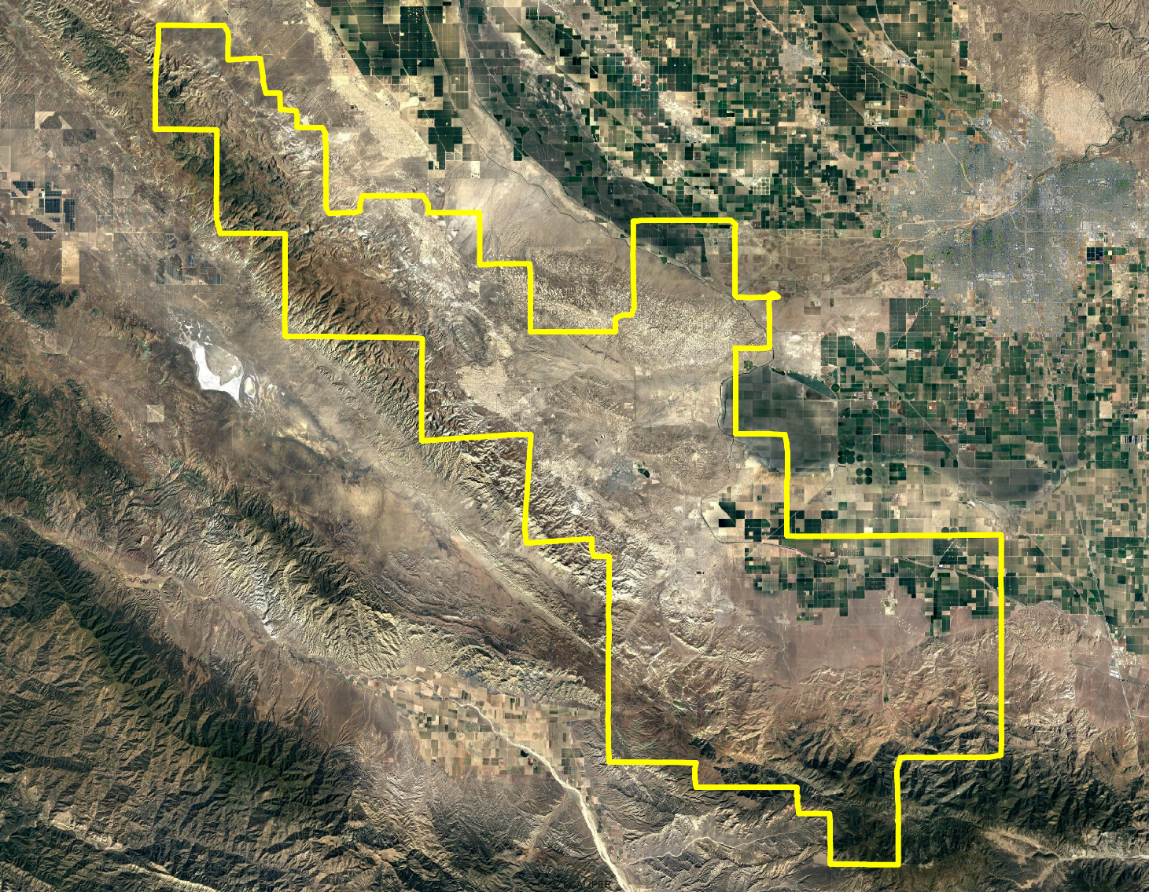
West Kern Community College District Draft Plan Presentation
Dr. Justin Levitt
Vice-President, National Demographics Corporation

Slide 2
Districting Process
Step | Description
Two Initial Hearings May 10 & June 14 | Held prior to release of draft maps. Education and to solicit input on the composition of districts.
Release draft maps August 2 | Maps must be posted at least 7 days prior to 3rd hearing.
Two hearings on draft maps July 12 & August 9 | Two meetings to discuss and revise the draft maps and to discuss the election sequence.
Map adoption September 13 | Map adopted via resolution. Final map must be posted at least 7 days prior to adoption.
* Reflects an approximate date

Slide 3
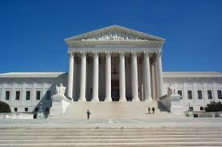
Districting Rules and Criteria
Federal Laws
Traditional Redistricting Principles
Equal Population
Federal Voting Rights Act
No Racial Gerrymandering
Communities of interest
Compact
Contiguous
Visible (Natural & man-made) boundaries
Respect voters’ choices / continuity in office
Planned future growth
Note: cities and counties have different criteria

Slide 4
Draft Maps
Drawn to illustrate a range of options
Each map illustrates a different way of balancing the “traditional redistricting principles”
Residents and the Board can suggest preferred ways to ‘mix and match’ the elements of the different maps
New maps Orange 2 and Yellow 2 added for this hearing
More detailed view available in the interactive review map.

Slide 5
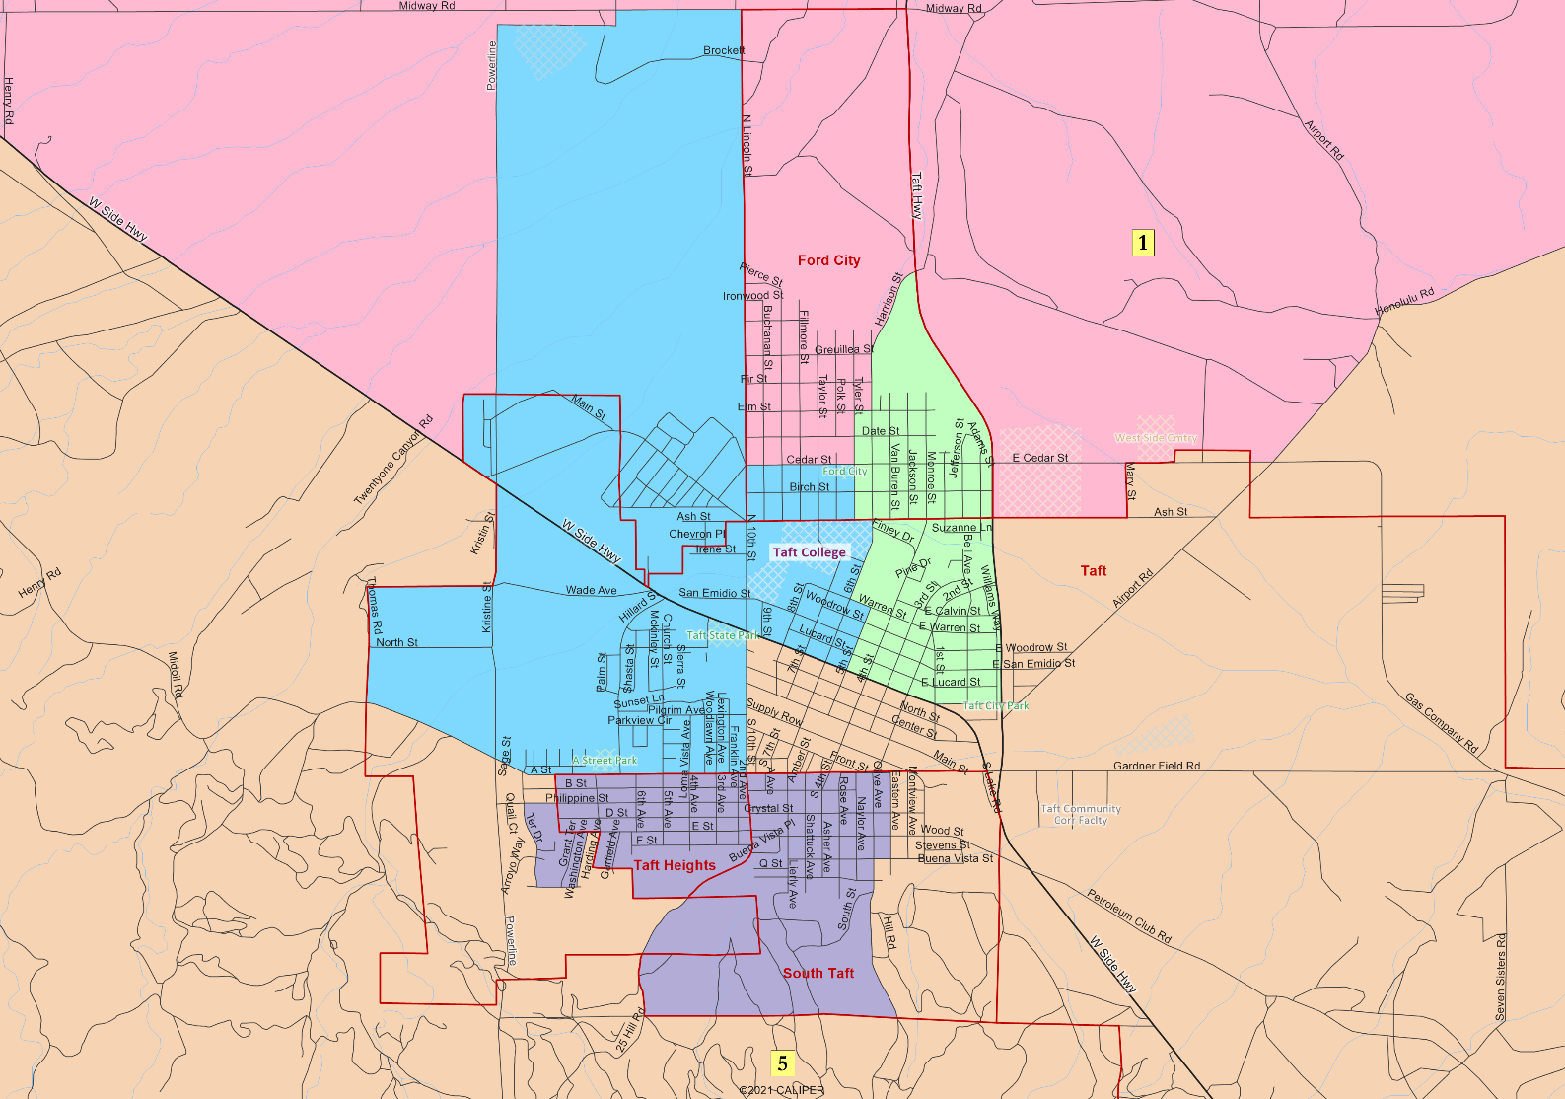
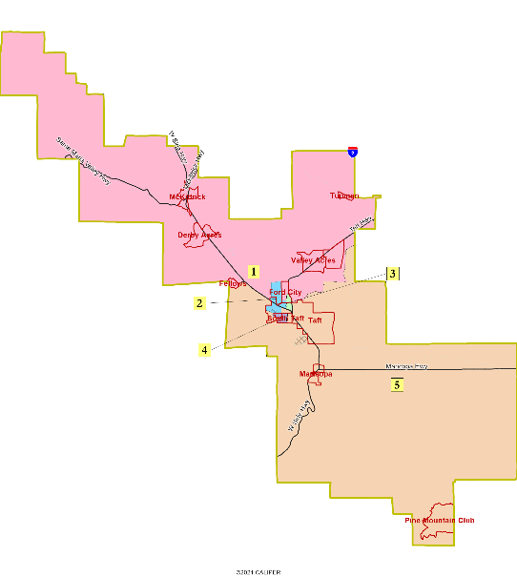
Sequence of Elections
Area 1 - 2026
Area 2 - 2026
Area 3 - 2024
Area 4 - 2026
Area 5 - 2024
Orange 2
4.6% deviation
32% Latino in Area 5
Moves Fellows into Area 1

Slide 6
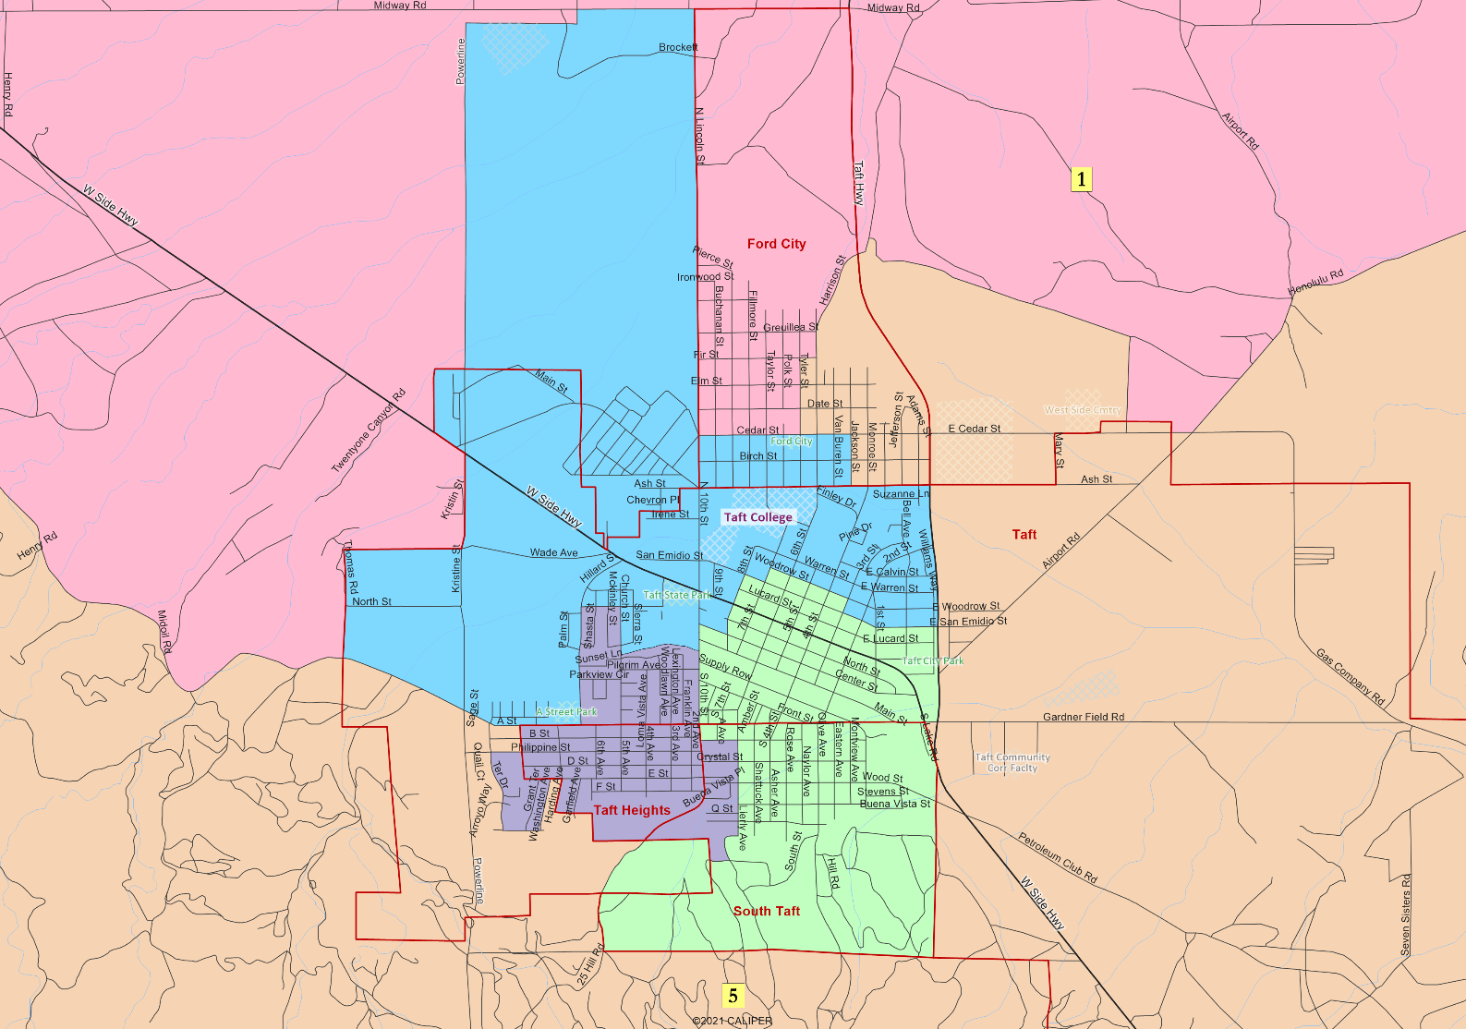
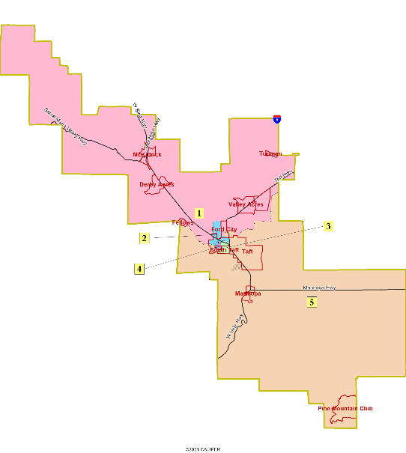
Sequence of Elections
Area 1 - 2026
Area 2 - 2026
Area 3 - 2024
Area 4 - 2026
Area 5 - 2024
Yellow 2
2.9% deviation
36% Latino in Area 3; 30% in Area 3
Moves Fellows into Area 1

Slide 7
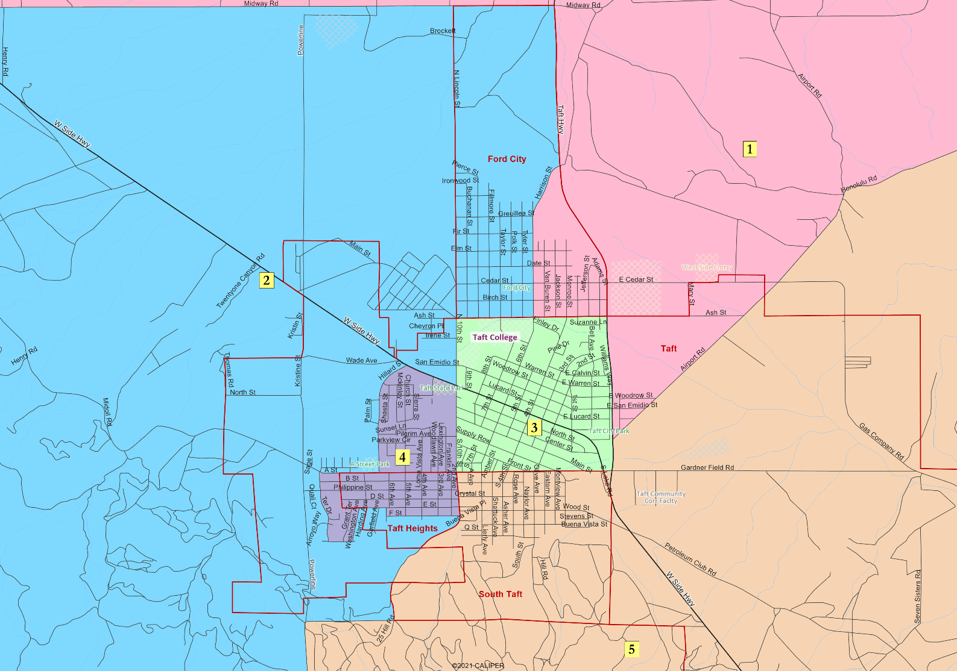
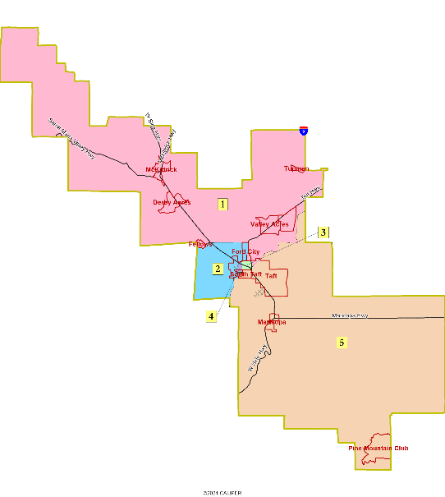
Sequence of Elections
Area 1 - 2026
Area 2 - 2026
Area 3 - 2024
Area 4 - 2026
Area 5 - 2024
NDC Green
2.8% deviation
35% Latino in Area 5; 27% in Area 3
Highly compact.
Keeps South Taft, central Taft together
Rural areas divided between Areas 1 & 5

Slide 8
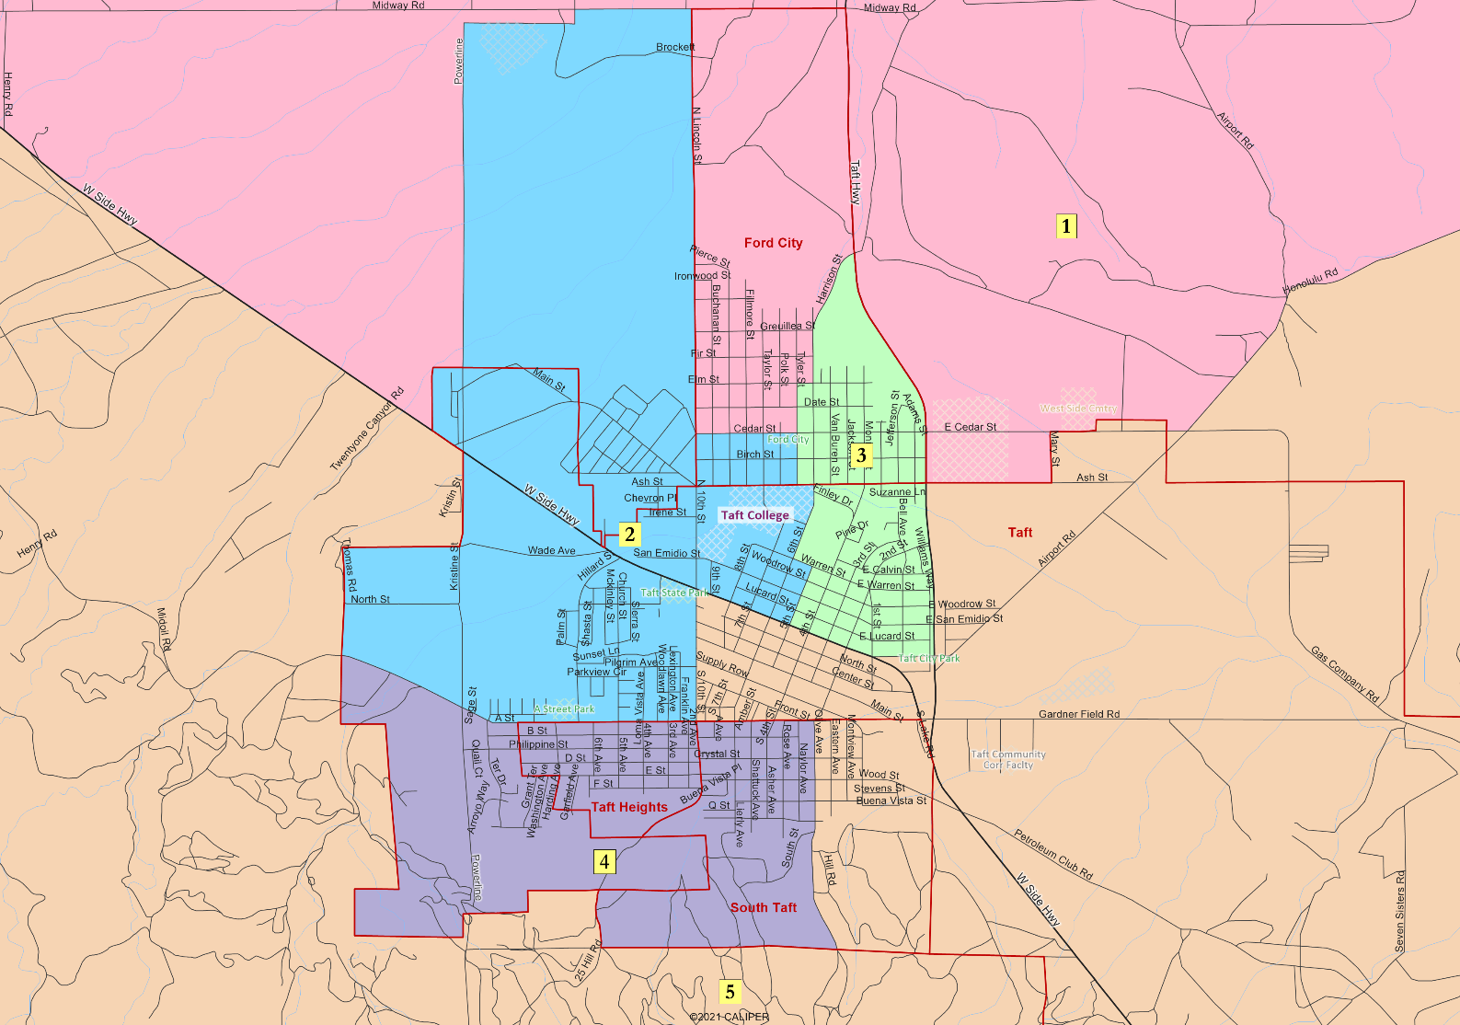
Sequence of Elections
Area 1 - 2026
Area 2 - 2026
Area 3 - 2024
Area 4 - 2026
Area 5 - 2024
NDC Orange
5.2% deviation
34% Latino in Area 5; 24% in Area 3
Follows Taft City boundaries – keeps 3 areas in urban area
Rural areas divided between Areas 1 & 5

Slide 9
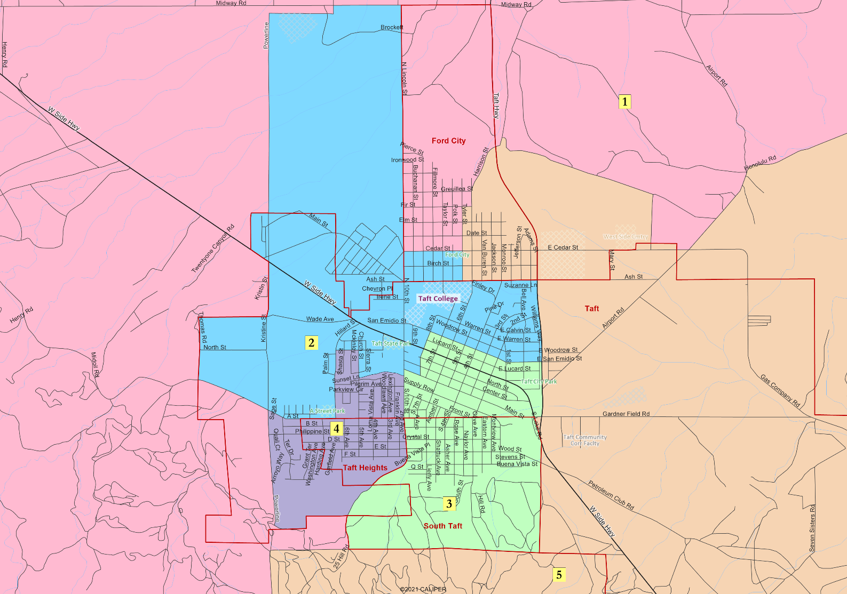
Sequence of Elections
Area 1 - 2026
Area 2 - 2026
Area 3 - 2024
Area 4 - 2026
Area 5 - 2024
NDC Yellow
4.3% deviation
33% Latino in Area 3; 31% in Area 5
Links central Taft and South Taft
Rural areas divided between Areas 1 & 5

Slide 10
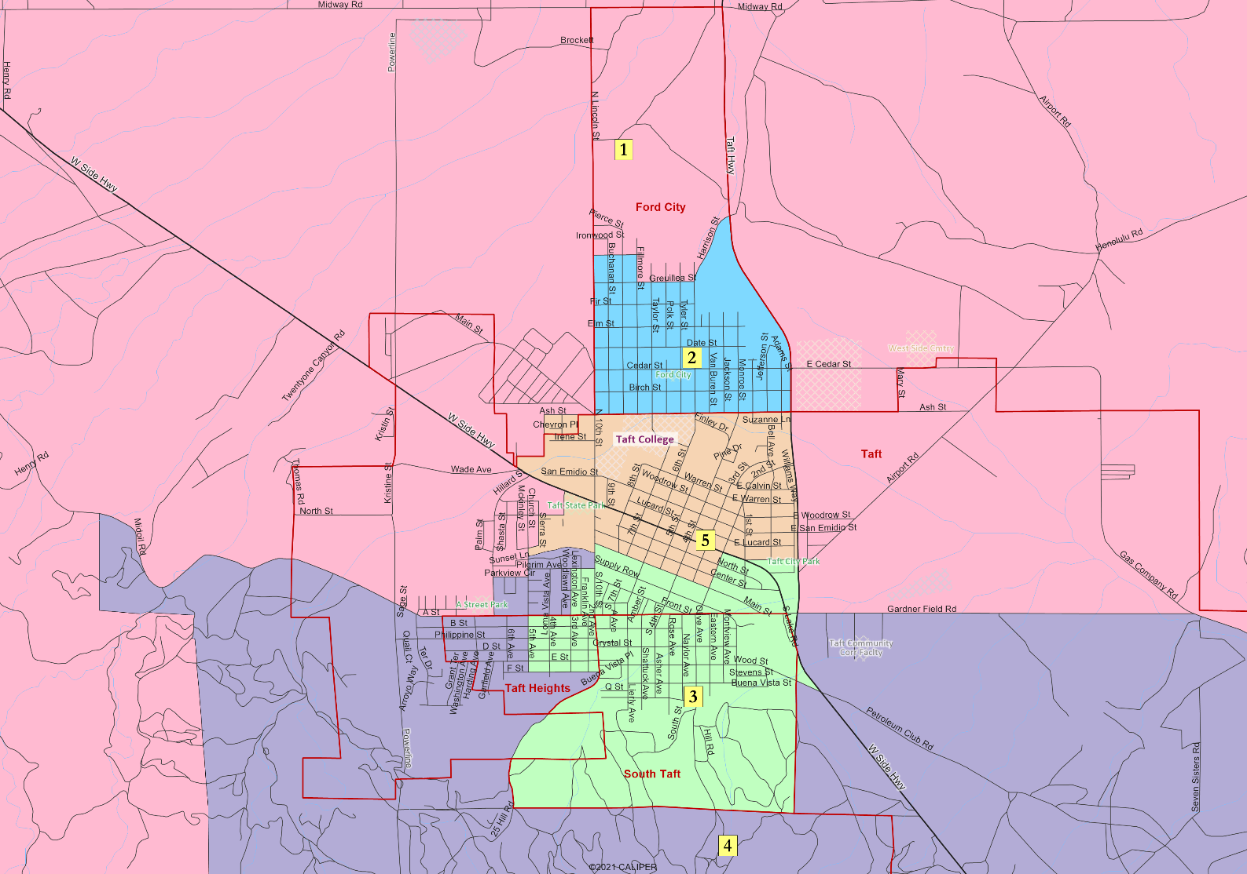
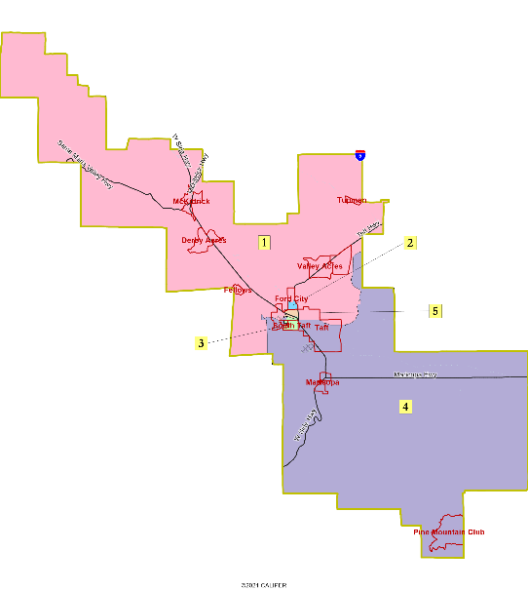
Sequence of Elections
Area 1 - 2026
Area 2 - 2026
Area 3 - 2026
Area 4 - 2024
Area 5 - 2024
Huerta Map
4.0% deviation
35% Latino in Area 3; 24% in Area 2

Slide 11
Hearing & Discussion
What do you like and dislike about each map?
Which map(s) do you prefer?
How can the preferred maps be improved?

Slide 12
Next Steps
NDC will revise the maps as requested.
Maps will be posted by September 6th (likely before that).
Hearing on September 13th with selection of map and sequence of election

